Slide 1
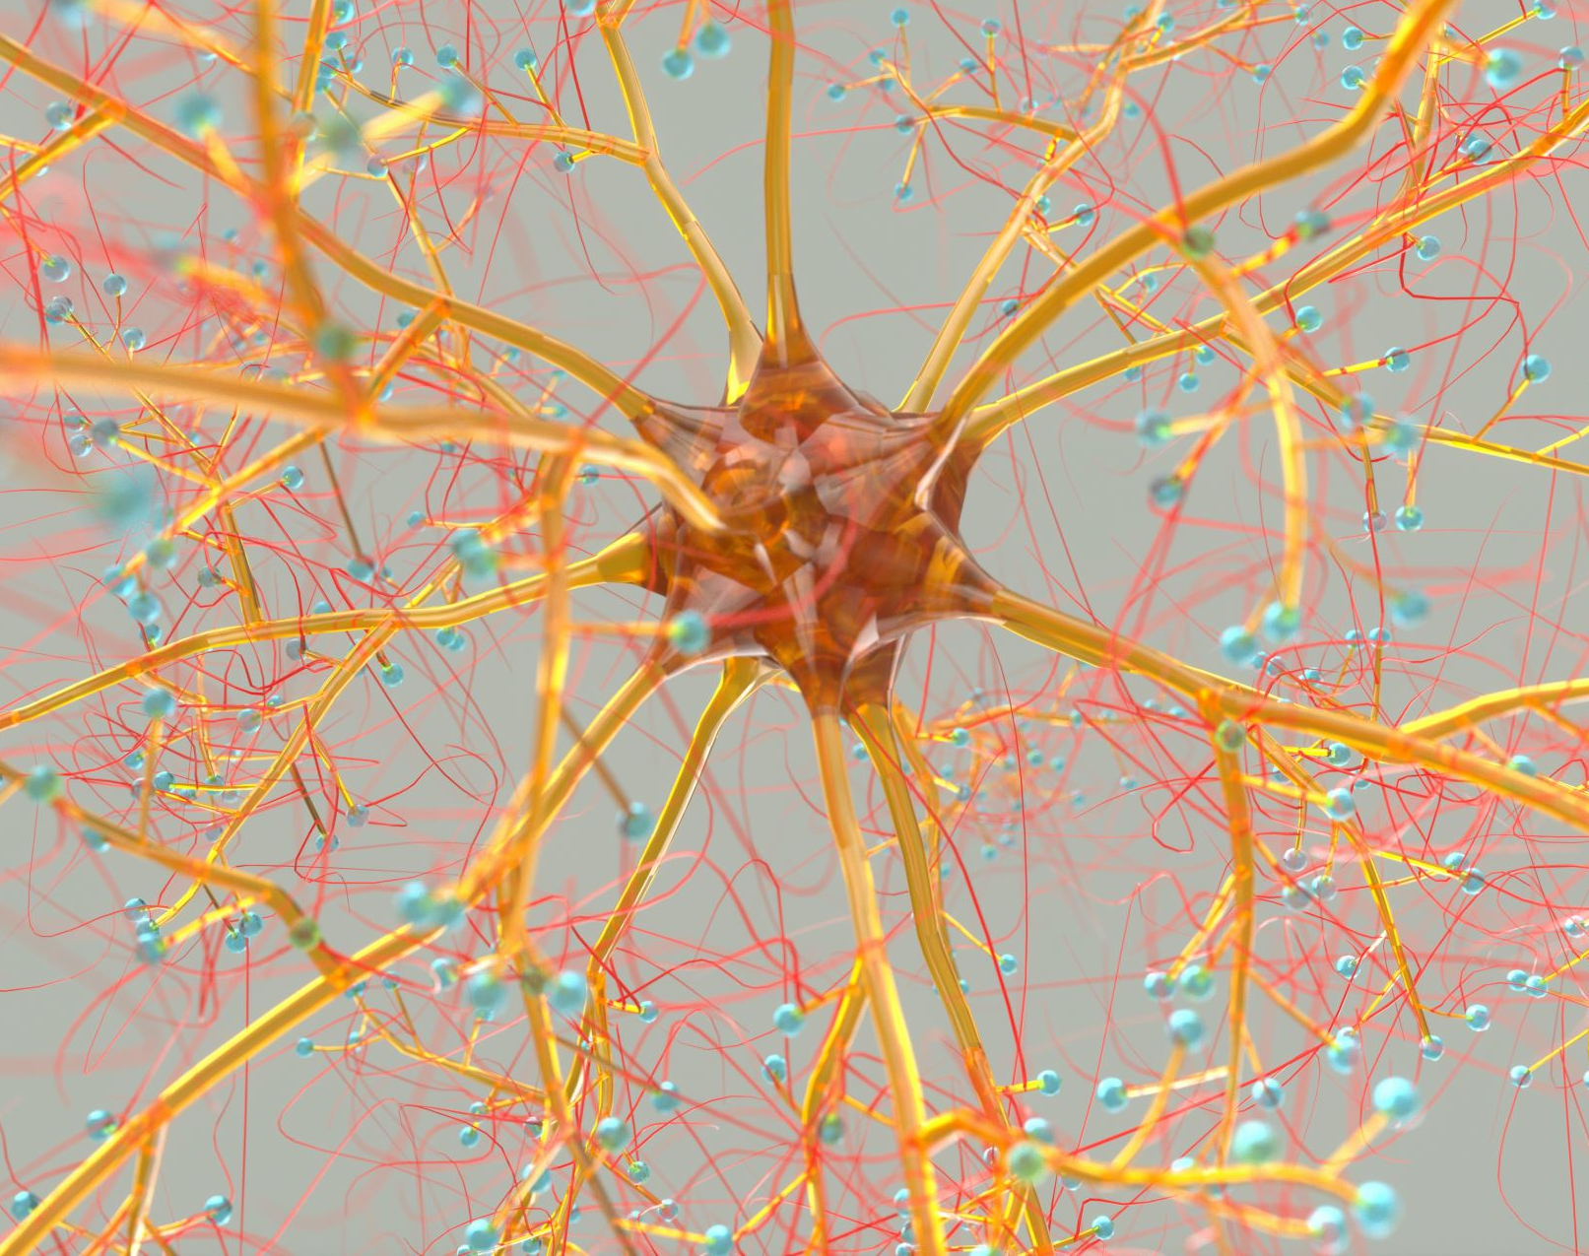
SEP 740 Deep Learning
Instructor: Dr. Anwar M. Mirza
mirzaa24@mcmaster.ca
Lecture No. 3
Backpropagation, Examples, Implementation

Slide 2



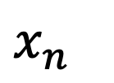

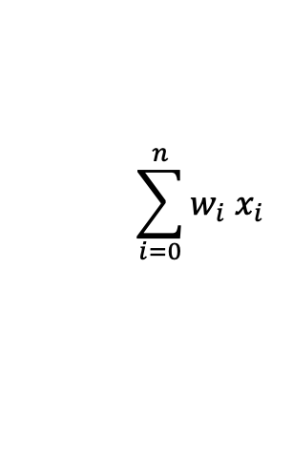
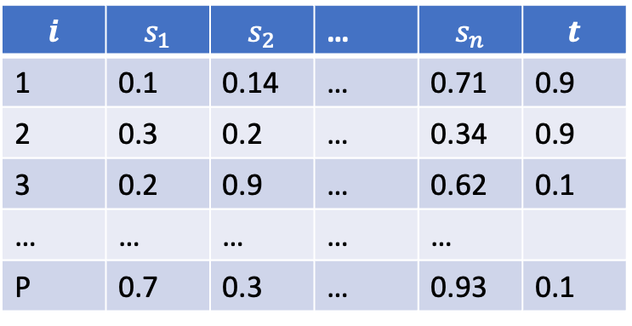

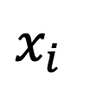

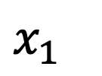





Binary Classification Problem
Binary Classification Dataset
$$1$$
$$i$$ | $$s_{1}$$ | $$s_{2}$$ | … | $$s_{n}$$ | $$t$$
1 | 0.1 | 0.14 | … | 0.71 | 0.9
2 | 0.3 | 0.2 | … | 0.34 | 0.9
3 | 0.2 | 0.9 | … | 0.62 | 0.1
… | … | … | … | …
P | 0.7 | 0.3 | … | 0.93 | 0.1
$$w_{0}$$
$$x_{1}$$
$$w_{1}$$
Y
$$y$$
$$w_{i}$$
$$x_{i}$$
$$w_{n}$$
Weighted sum of all inputs reaching at Y
$$\sum_{i=0}^{n}{w_{i} x_{i}}$$
$yin=w_{0}+w_{1} x_{1}$ $+ w_{2} x_{2}$ $+$ … $+ w_{n} x_{n}=$
$$x_{n}$$
Output of the neuron Y
$$y=f(yin)$$
Weight Update
$w_{i} \left(new\right)=w_{i} \left(old\right)+$ $∆w_{i}$
Perceptron Rule
Delta Rule – Widrow-Hoff Rule –
Least Mean Squares (LMS) Method
$$∆w_{i}={ηx}_{i} t$$
$∆w_{i}={η x}_{i} (t−y)$ = ${η x}_{i}δ$

Slide 3

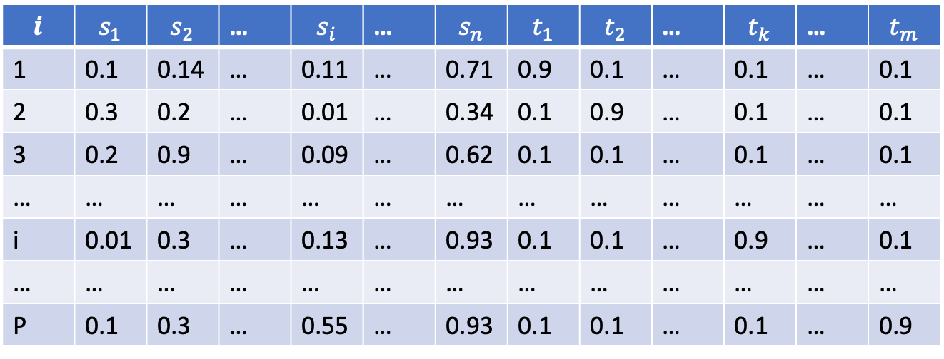
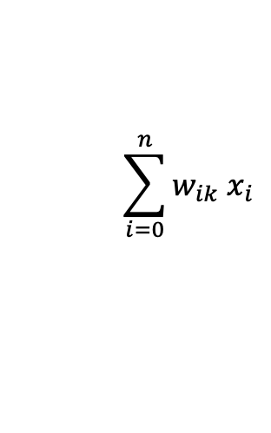












Multi-class Problem
Single-Layer Feedforward
Neural Network
$$i$$ | $$s_{1}$$ | $$s_{2}$$ | … | $$s_{i}$$ | … | $$s_{n}$$ | $$t_{1}$$ | $$t_{2}$$ | … | $$t_{k}$$ | … | $$t_{m}$$
1 | 0.1 | 0.14 | … | 0.11 | … | 0.71 | 0.9 | 0.1 | … | 0.1 | … | 0.1
2 | 0.3 | 0.2 | … | 0.01 | … | 0.34 | 0.1 | 0.9 | … | 0.1 | … | 0.1
3 | 0.2 | 0.9 | … | 0.09 | … | 0.62 | 0.1 | 0.1 | … | 0.1 | … | 0.1
… | … | … | … | … | … | … | … | … | … | … | … | …
i | 0.01 | 0.3 | … | 0.13 | … | 0.93 | 0.1 | 0.1 | … | 0.9 | … | 0.1
… | … | … | … | … | … | … | … | … | … | … | … | …
P | 0.1 | 0.3 | … | 0.55 | … | 0.93 | 0.1 | 0.1 | … | 0.1 | … | 0.9
1
$$w_{01}$$
$$w_{02}$$
X₁
$$w_{11}$$
Y₁
$$w_{12}$$
X₂
Y₂
$$w_{2m}$$
Weighted sum of all inputs reaching at Y_{k}
$$\sum_{i=0}^{n}{w_{ik} x_{i}}$$
X_{j}
Y_{k}
$$w_{ik}$$
${yin}_{k}=w_{0k}+w_{1k} x_{1}$ $+ w_{2k} x_{2}$ $+$ … $+ w_{nk} x_{n}=$
$$w_{im}$$
Output of the neuron Y
$$y=f({yin}_{k})$$
Weight Update
X_{n}
Y_{m}
$$w_{nm}$$
$w_{ik} \left(new\right)=w_{ik} \left(old\right)+$ $∆w_{ik}$
Perceptron Rule – for Multi-Output Neurons
Delta (LMS) Rule – for Multi-Output Neurons
$∆w_{ik}=$ ${η x}_{i}{ t}_{k}$
$∆w_{ik}=$ ${η x}_{i} \left(t_{k}−{yin}_{k}\right)={η x}_{i} δ_{k}$

Slide 4
Limitations of a Single-Layer Feedforward Network (SLFN)
Cannot Solve Non-Linearly Separable Problems
A single-layer perceptron can only learn linearly separable functions (i.e., problems where data can be divided by a straight line/hyperplane).
It fails on classic non-linear problems like the XOR problem, which requires at least one hidden layer (making it a multi-layer perceptron, MLP).
Limited to Linear Decision Boundaries
Since it lacks hidden layers, it can only model linear relationships between inputs and outputs.
Real-world data often requires non-linear decision boundaries, which SLFNs cannot represent.
No Feature Hierarchy or Abstraction
Deep networks learn hierarchical features (e.g., edges → shapes → objects in images), but SLFNs cannot extract higher-level features since they lack hidden layers.
Limited Expressivity (Representational Power)
The Universal Approximation Theorem states that a single hidden layer is sufficient to approximate any continuous function, but a zero-hidden-layer network (SLFN) cannot.
Sensitive to Input Scaling & Preprocessing
Since SLFNs rely on linear transformations, they perform poorly if features are not normalized or are highly correlated.
No Ability to Handle Sequential or Temporal Data
Unlike recurrent neural network RNNs or long shot-term memory LSTMs, SLFNs have no memory and cannot process sequences or time-dependent data.
Vulnerable to Overfitting if Input Dimensionality is High
If the input features are numerous, a single-layer network may overfit due to limited learning capacity.

Slide 5












Two-Layer Feedforward Neural Network
1
$$v_{01}$$
1
$$w_{01}$$
$$v_{02}$$
$$w_{02}$$
X₁
$$v_{11}$$
Z₁
$$w_{11}$$
Y₁
$$v_{12}$$
$$w_{12}$$
X₂
Z₂
Y₂
$$v_{2p}$$
$$w_{2m}$$
X_{i}
Z_{j}
Y_{k}
$$v_{ij}$$
$$w_{jk}$$
$$v_{ip}$$
$$w_{jm}$$
X_{n}
$$v_{np}$$
Z_{p}
Y_{m}
$$w_{pm}$$

Slide 6























Two-Layer Feedforward Neural Network
$$η=0.1$$
1
$$v_{01}=0.5$$
1
$$w_{01}=0.3$$
$$f(x)=x$$
$$v_{02}=−0.6$$
X₁
$$v_{11}=−0.3$$
Z₁
$$w_{11}=−0.5$$
$$s_{1}=0.9$$
Y
$$t=0.6$$
$$v_{12}=0.1$$
$$v_{21}=0.2$$
$$w_{21}=0.7$$
$$s_{2}=0.1$$
X₂
Z₂
$$v_{22}=0.4$$
$$v_{01}=0.5$$
$$v_{02}=−0.6$$
$$w_{01}=0.3$$
$$v_{11}=−0.3$$
$$v_{12}=0.1$$
$$w_{11}=−0.5$$
$$v_{21}=0.2$$
$$v_{22}=0.4$$
$$w_{21}=0.7$$

Slide 7
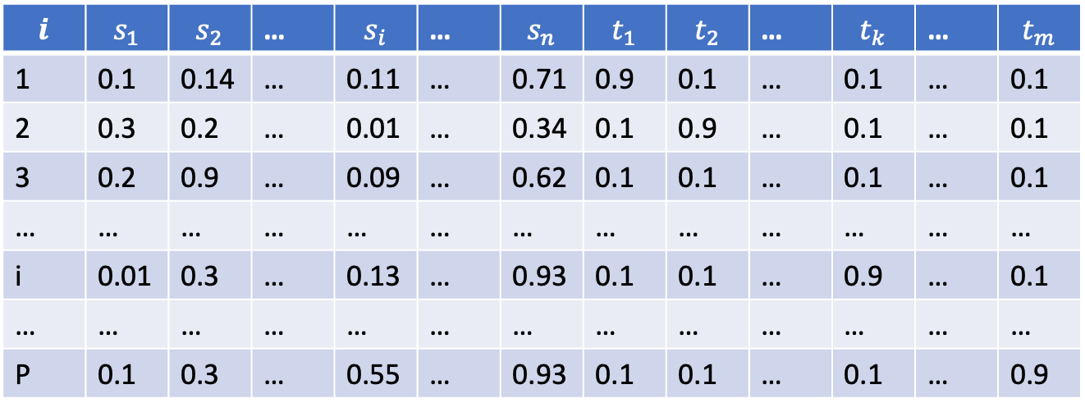

Multi-class Problem
$$i$$ | $$s_{1}$$ | $$s_{2}$$ | … | $$s_{i}$$ | … | $$s_{n}$$ | $$t_{1}$$ | $$t_{2}$$ | … | $$t_{k}$$ | … | $$t_{m}$$
1 | 0.1 | 0.14 | … | 0.11 | … | 0.71 | 0.9 | 0.1 | … | 0.1 | … | 0.1
2 | 0.3 | 0.2 | … | 0.01 | … | 0.34 | 0.1 | 0.9 | … | 0.1 | … | 0.1
3 | 0.2 | 0.9 | … | 0.09 | … | 0.62 | 0.1 | 0.1 | … | 0.1 | … | 0.1
… | … | … | … | … | … | … | … | … | … | … | … | …
i | 0.01 | 0.3 | … | 0.13 | … | 0.93 | 0.1 | 0.1 | … | 0.9 | … | 0.1
… | … | … | … | … | … | … | … | … | … | … | … | …
P | 0.1 | 0.3 | … | 0.55 | … | 0.93 | 0.1 | 0.1 | … | 0.1 | … | 0.9
Delta Rule – for Multi-Output Neurons
$w_{ik} \left(new\right)=w_{ik} \left(old\right)+$ ${α s}_{i} (t_{k}−{yin}_{k})$
${yin}_{k}=w_{0k}+w_{1k} x_{1}$ $+ w_{2k} x_{2}$ $+$ … $+ w_{nk} x_{n}$

Slide 8
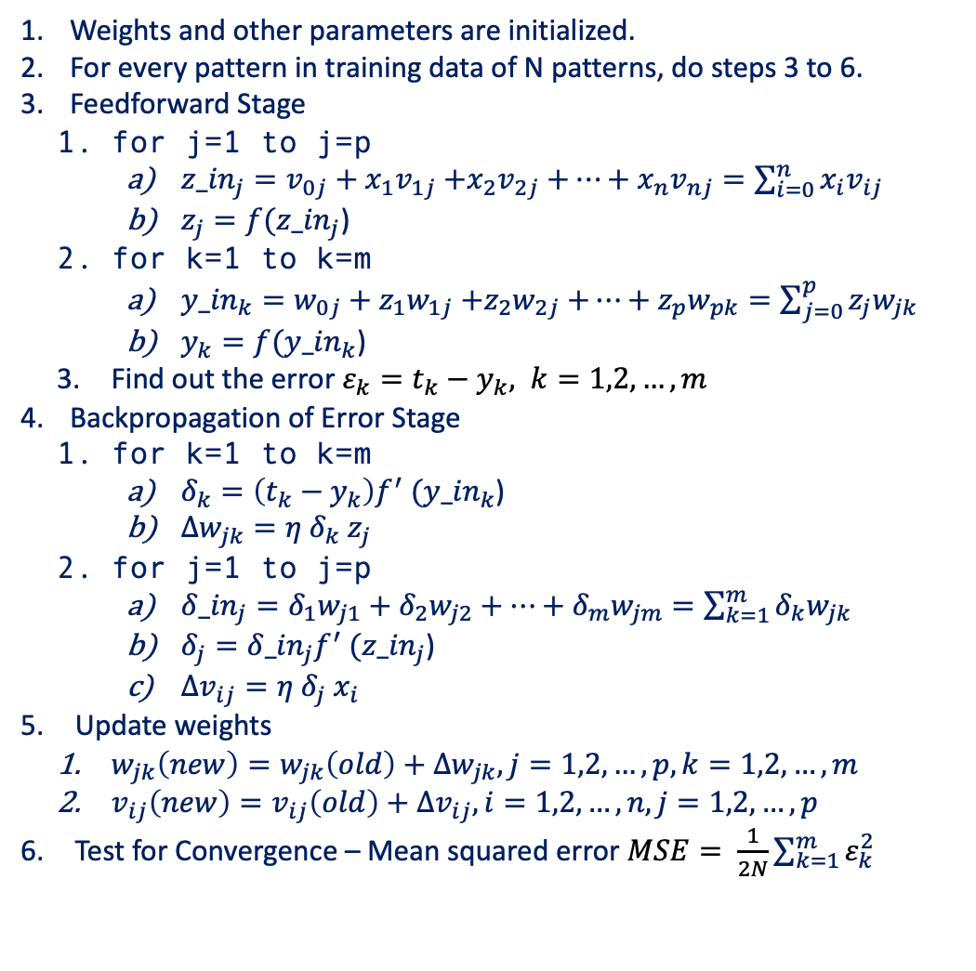
Two-Layer Feedforward Neural Network – Backpropagation Algorithm
Architecture
Algorithm
Weights and other parameters are initialized.
For every pattern in training data of N patterns, do steps 3 to 6.
Feedforward Stage
for j=1 to j=p
${z_in}_{j}=v_{0j}+x_{1}v_{1j}$ $+x_{2}v_{2j}$ $+⋯+x_{n}v_{nj}=\sum_{i=0}^{n}{x_{i}v_{ij}}$
$z_{j}=f({z_in}_{j}$)
for k=1 to k=m
${y_in}_{k}=w_{0j}+z_{1}w_{1j}$ $+z_{2}w_{2j}$ $+⋯+z_{p}w_{pk}=\sum_{j=0}^{p}{z_{j}w_{jk}}$
$y_{k}=f({y_in}_{k}$)
Find out the error $ε_{k}=t_{k}−y_{k}, k=1,2,…,m$
Backpropagation of Error Stage
for k=1 to k=m
$δ_{k}=\left(t_{k}−y_{k}\right)f^{′} ({y_in}_{k}\text{)}$
${Δw}_{jk}=η δ_{k} z_{j}$
for j=1 to j=p
${δ_in}_{j}=δ_{1}w_{j1}+δ_{2}w_{j2}+⋯+δ_{m}w_{jm}=\sum_{k=1}^{m}{δ_{k}w_{jk}}$
$δ_{j}={δ_in}_{j}f^{′} ({z_in}_{j}\text{)}$
${Δv}_{ij}=η δ_{j} x_{i}$
Update weights
$w_{jk}\left(new\right)=w_{jk}\left(old\right)+{Δw}_{jk}, j=1,2,…,p, k=1,2,…,m$
$v_{ij}\left(new\right)=v_{ij}\left(old\right)+{Δv}_{ij}, i=1,2,…,n, j=1,2,…,p$
Test for Convergence – Mean squared error $MSE= \frac{1}{2N}\sum_{k=1}^{m}{ε_{k}^{2}}$
1
$$v_{01}$$
1
$$w_{01}$$
$$v_{02}$$
$$w_{02}$$
X₁
$$v_{11}$$
Z₁
$$w_{11}$$
Y₁
$$v_{12}$$
$$w_{12}$$
X₂
Z₂
Y₂
$$v_{2p}$$
$$w_{2m}$$
X_{i}
Z_{j}
Y_{k}
$$v_{ij}$$
$$w_{jk}$$
$$v_{ip}$$
$$w_{jm}$$
X_{n}
$$v_{np}$$
Z_{p}
$$w_{pm}$$
Y_{m}

Slide 9












Two-Layer Feedforward Neural Network
$$η=0.1$$
1
$$v_{01}$$
1
$$w_{01}$$
$$f(x)=x$$
$$v_{02}$$
$$v_{11}$$
$$w_{11}$$
$$s_{1}=0.9$$
X₁
Z₁
Y
$$v_{12}$$
$$t=0.6$$
$$v_{21}$$
X₂
Z₂
$$w_{21}$$
$$s_{2}=0.1$$
$$v_{22}$$
$$v_{01}=0.5$$
$$v_{02}=−0.6$$
$$w_{01}=0.3$$
$$v_{11}=−0.3$$
$$v_{12}=0.1$$
$$w_{11}=−0.5$$
$$v_{21}=0.2$$
$$v_{22}=0.4$$
$$w_{21}=0.7$$
$$v_{31}=−0.4$$
$$v_{32}=−0.2$$

Slide 10








Two-Layer Feedforward Neural Network
$$η=0.1$$
$$f(x)=x$$
1
$$v_{01}$$
1
$$w_{01}$$
$$v_{02}$$
$$v_{11}$$
$$w_{11}$$
$$s_{1}=0.8$$
X₁
Z₁
Y
$$t=0.6$$
$$v_{12}$$
$$v_{21}$$
X₂
Z₂
$$w_{21}$$
$$s_{2}=−0.2$$
$$v_{22}$$
$$v_{31}$$
$$v_{32}$$
$$s_{3}=0.5$$
X₃
$$v_{01}=0.5$$
$$v_{02}=−0.6$$
$$w_{01}=0.3$$
$$v_{11}=−0.3$$
$$v_{12}=0.1$$
$$w_{11}=−0.5$$
$$v_{21}=0.2$$
$$v_{22}=0.4$$
$$w_{21}=0.7$$
$$v_{31}=−0.4$$
$$v_{32}=−0.2$$

Slide 11





Two-Layer Feedforward Neural Network
1
$$v_{01}$$
1
$$w_{0}$$
$$v_{02}$$
X₁
$$v_{11}$$
Z₁
$$w_{1}$$
Y
$$v_{12}$$
X₂
Z₂
$$w_{2}$$
$$v_{2p}$$
X_{i}
Z_{j}
$$w_{j}$$
$$v_{ij}$$
$$v_{ip}$$
$$w_{p}$$
X_{n}
$$v_{np}$$
Z_{p}

Slide 12










Two-Layer Feedforward Neural Network
1
$$v_{01}$$
1
$$w_{01}$$
$$v_{02}$$
X₁
$$v_{11}$$
Z₁
$$w_{11}$$
Y₁
$$v_{12}$$
X₂
Z₂
$$w_{12}$$
$$v_{2p}$$
Z_{j}
$$w_{j1}$$
Z_{p}
$$w_{p1}$$

Slide 13
























Many-Layer Feedforward Neural Network
1
$$v_{01}$$
1
$$w_{01}$$
$$v_{02}$$
$$w_{02}$$
X₁
$$v_{11}$$
$$Z_{1}^{(1)}$$
$$Z_{1}^{(L)}$$
$$w_{11}$$
Y₁
$$v_{12}$$
$$w_{12}$$
X₂
$$Z_{2}^{(1)}$$
$$Z_{2}^{(L)}$$
Y₂
$$v_{2p}$$
$$w_{2m}$$
X_{i}
$$Z_{j}^{(1)}$$
$$Z_{j}^{(L)}$$
Y_{k}
$$v_{ij}$$
$$w_{jk}$$
$$v_{ip}$$
$$w_{jm}$$
X_{n}
$$Z_{P_{1}}^{(1)}$$
$$Z_{P_{L}}^{(L)}$$
Y_{m}
$$v_{np}$$
$$w_{pm}$$
Input
Hidden Layer 1
Hidden Layer L
Output Layer

Slide 14




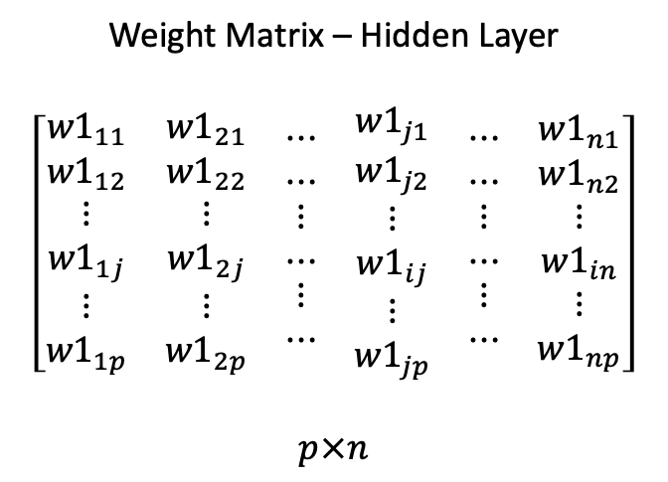



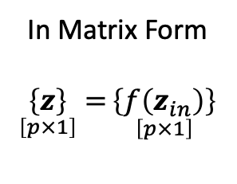




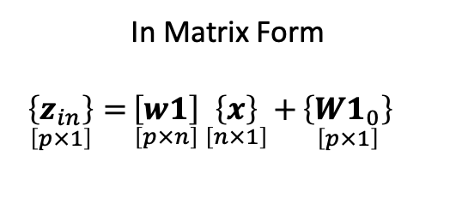


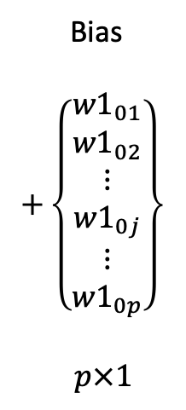

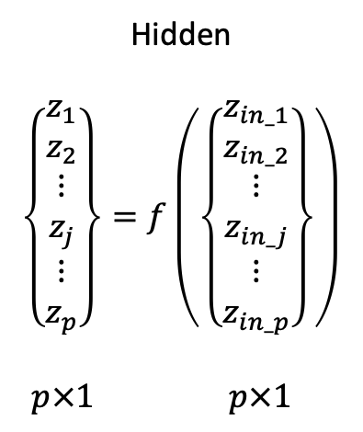



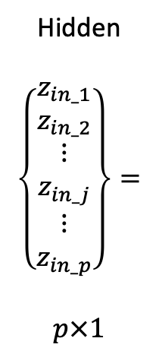
Feedforward Step
Hidden
$$\left\{\begin{matrix}\begin{matrix}z_{in_1} \\ z_{in_2}\end{matrix} \\ \begin{matrix}⋮ \\ z_{in_j}\end{matrix} \\ \begin{matrix}⋮ \\ z_{in_p}\end{matrix}\end{matrix}\right\}=$$
$$p×1$$
Weight Matrix – Hidden Layer
$$\left[\begin{matrix}\begin{matrix}\begin{matrix}\begin{matrix}{w1}_{11} \\ {w1}_{12}\end{matrix} \\ \begin{matrix}⋮ \\ {w1}_{1j}\end{matrix} \\ \begin{matrix}⋮ \\ {w1}_{1p}\end{matrix}\end{matrix} & \begin{matrix}\begin{matrix}{w1}_{21} \\ {w1}_{22}\end{matrix} \\ \begin{matrix}⋮ \\ {w1}_{2j}\end{matrix} \\ \begin{matrix}⋮ \\ {w1}_{2p}\end{matrix}\end{matrix}\end{matrix} & \begin{matrix}\begin{matrix}\begin{matrix}⋯ \\ ⋯\end{matrix} \\ \begin{matrix}⋮ \\ ⋯\end{matrix} \\ \begin{matrix}⋮ \\ ⋯\end{matrix}\end{matrix} & \begin{matrix}\begin{matrix}{w1}_{j1} \\ {w1}_{j2}\end{matrix} \\ \begin{matrix}⋮ \\ {w1}_{ij}\end{matrix} \\ \begin{matrix}⋮ \\ {w1}_{jp}\end{matrix}\end{matrix}\end{matrix} & \begin{matrix}\begin{matrix}\begin{matrix}⋯ \\ ⋯\end{matrix} \\ \begin{matrix}⋮ \\ ⋯\end{matrix} \\ \begin{matrix}⋮ \\ ⋯\end{matrix}\end{matrix} & \begin{matrix}\begin{matrix}{w1}_{n1} \\ {w1}_{n2}\end{matrix} \\ \begin{matrix}⋮ \\ {w1}_{in}\end{matrix} \\ \begin{matrix}⋮ \\ {w1}_{np}\end{matrix}\end{matrix}\end{matrix}\end{matrix}\right]$$
$$p×n$$
Input
$$\left\{\begin{matrix}\begin{matrix}x_{1} \\ x_{2}\end{matrix} \\ \begin{matrix}⋮ \\ x_{i}\end{matrix} \\ \begin{matrix}⋮ \\ x_{n}\end{matrix}\end{matrix}\right\}$$
$$n×1$$
Bias
$$+\left\{\begin{matrix}\begin{matrix}{w1}_{01} \\ {w1}_{02}\end{matrix} \\ \begin{matrix}⋮ \\ {w1}_{0j}\end{matrix} \\ \begin{matrix}⋮ \\ {w1}_{0p}\end{matrix}\end{matrix}\right\}$$
$$p×1$$
In Matrix Form
$$\underset{\left[p×1\right]}{\left\{z_{in}\right\}}{=}\underset{\left[p×n\right]}{\left[w1\right]}{\underset{\left[n×1\right]}{\left\{x\right\}}{+\underset{\left[p×1\right]}{\left\{{W1}_{0}\right\}}{}}}$$
1
$${w1}_{01}$$
1
$${w2}_{01}$$
$${w1}_{02}$$
$${w2}_{02}$$
X₁
$${w1}_{11}$$
Z₁
$${w2}_{11}$$
Y₁
$${w1}_{12}$$
$${w2}_{12}$$
Hidden
$$\left\{\begin{matrix}\begin{matrix}z_{1} \\ z_{2}\end{matrix} \\ \begin{matrix}⋮ \\ z_{j}\end{matrix} \\ \begin{matrix}⋮ \\ z_{p}\end{matrix}\end{matrix}\right\}=f\left(\left\{\begin{matrix}\begin{matrix}z_{in_1} \\ z_{in_2}\end{matrix} \\ \begin{matrix}⋮ \\ z_{in_j}\end{matrix} \\ \begin{matrix}⋮ \\ z_{in_p}\end{matrix}\end{matrix}\right\}\right)$$
$$\begin{matrix}p×1 & p×1 \end{matrix}$$
X₂
Z₂
Y₂
In Matrix Form
$$\underset{\left[p×1\right]}{\left\{z\right\}}{=}\underset{\left[p×1\right]}{\left\{f\left(z_{in}\right)\right\}}$$
$${w1}_{2p}$$
$${w2}_{2m}$$
X_{i}
Z_{j}
Y_{k}
$${w1}_{ij}$$
$${w2}_{jk}$$
$${w1}_{ip}$$
$$w_{2jm}$$
X_{n}
Z_{p}
Y_{m}
Two-Layer Feedforward Neural Network
$${w1}_{np}$$
$${w2}_{pm}$$

Slide 15

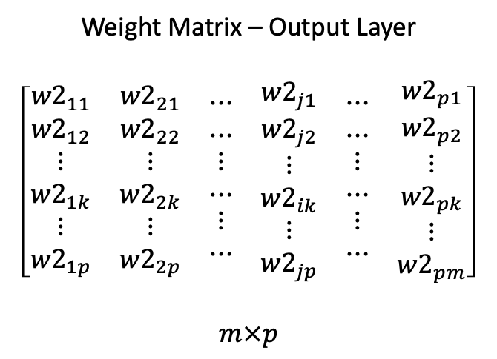
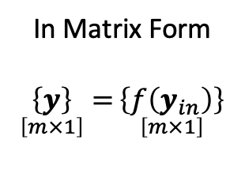
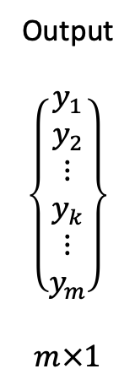
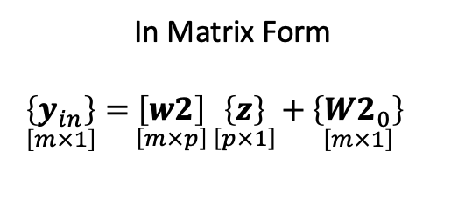
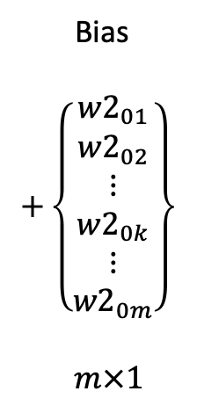
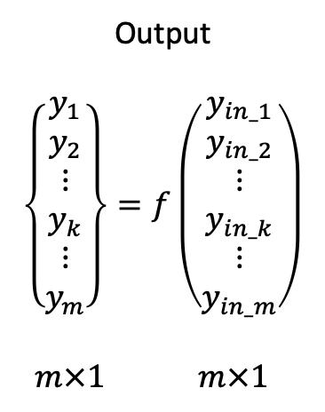
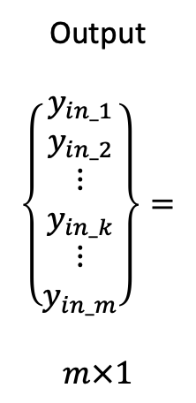
Output
$$\left\{\begin{matrix}\begin{matrix}y_{in_1} \\ y_{in_2}\end{matrix} \\ \begin{matrix}⋮ \\ y_{in_k}\end{matrix} \\ \begin{matrix}⋮ \\ y_{in_m}\end{matrix}\end{matrix}\right\}=$$
$$m×1$$
Weight Matrix – Output Layer
$$\left[\begin{matrix}\begin{matrix}\begin{matrix}\begin{matrix}{w2}_{11} \\ {w2}_{12}\end{matrix} \\ \begin{matrix}⋮ \\ {w2}_{1k}\end{matrix} \\ \begin{matrix}⋮ \\ {w2}_{1p}\end{matrix}\end{matrix} & \begin{matrix}\begin{matrix}{w2}_{21} \\ {w2}_{22}\end{matrix} \\ \begin{matrix}⋮ \\ {w2}_{2k}\end{matrix} \\ \begin{matrix}⋮ \\ {w2}_{2p}\end{matrix}\end{matrix}\end{matrix} & \begin{matrix}\begin{matrix}\begin{matrix}⋯ \\ ⋯\end{matrix} \\ \begin{matrix}⋮ \\ ⋯\end{matrix} \\ \begin{matrix}⋮ \\ ⋯\end{matrix}\end{matrix} & \begin{matrix}\begin{matrix}{w2}_{j1} \\ {w2}_{j2}\end{matrix} \\ \begin{matrix}⋮ \\ {w2}_{ik}\end{matrix} \\ \begin{matrix}⋮ \\ {w2}_{jp}\end{matrix}\end{matrix}\end{matrix} & \begin{matrix}\begin{matrix}\begin{matrix}⋯ \\ ⋯\end{matrix} \\ \begin{matrix}⋮ \\ ⋯\end{matrix} \\ \begin{matrix}⋮ \\ ⋯\end{matrix}\end{matrix} & \begin{matrix}\begin{matrix}{w2}_{p1} \\ {w2}_{p2}\end{matrix} \\ \begin{matrix}⋮ \\ {w2}_{pk}\end{matrix} \\ \begin{matrix}⋮ \\ {w2}_{pm}\end{matrix}\end{matrix}\end{matrix}\end{matrix}\right]$$
$$m×p$$
Hidden
$$\left\{\begin{matrix}\begin{matrix}z_{1} \\ z_{2}\end{matrix} \\ \begin{matrix}⋮ \\ z_{i}\end{matrix} \\ \begin{matrix}⋮ \\ z_{p}\end{matrix}\end{matrix}\right\}$$
$$p×1$$
Bias
$$+\left\{\begin{matrix}\begin{matrix}{w2}_{01} \\ {w2}_{02}\end{matrix} \\ \begin{matrix}⋮ \\ {w2}_{0k}\end{matrix} \\ \begin{matrix}⋮ \\ {w2}_{0m}\end{matrix}\end{matrix}\right\}$$
$$m×1$$
Feedforward Step
In Matrix Form
$$\underset{\left[m×1\right]}{\left\{y_{in}\right\}}{=}\underset{\left[m×p\right]}{\left[w2\right]}{\underset{\left[p×1\right]}{\left\{z\right\}}{+\underset{\left[m×1\right]}{\left\{{W2}_{0}\right\}}{}}}$$
1
$${w1}_{01}$$
1
$${w2}_{01}$$
$${w1}_{02}$$
$${w2}_{02}$$
X₁
$${w1}_{11}$$
Z₁
$${w2}_{11}$$
Y₁
$${w1}_{12}$$
$${w2}_{12}$$
Output
$$\left\{\begin{matrix}\begin{matrix}y_{1} \\ y_{2}\end{matrix} \\ \begin{matrix}⋮ \\ y_{k}\end{matrix} \\ \begin{matrix}⋮ \\ y_{m}\end{matrix}\end{matrix}\right\}=f\left(\begin{matrix}\begin{matrix}y_{in_1} \\ y_{in_2}\end{matrix} \\ \begin{matrix}⋮ \\ y_{in_k}\end{matrix} \\ \begin{matrix}⋮ \\ y_{in_m}\end{matrix}\end{matrix}\right)$$
$$\begin{matrix}m×1 & m×1 \end{matrix}$$
Output
$$\left\{\begin{matrix}\begin{matrix}y_{1} \\ y_{2}\end{matrix} \\ \begin{matrix}⋮ \\ y_{k}\end{matrix} \\ \begin{matrix}⋮ \\ y_{m}\end{matrix}\end{matrix}\right\}$$
$$m×1$$
X₂
Z₂
Y₂
In Matrix Form
$$\underset{\left[m×1\right]}{\left\{y\right\}}{=}\underset{\left[m×1\right]}{\left\{f\left(y_{in}\right)\right\}}$$
$${w1}_{2p}$$
$${w2}_{2m}$$
X_{i}
Z_{j}
Y_{k}
$${w1}_{ij}$$
$${w2}_{jk}$$
$${w1}_{ip}$$
$$w_{2jm}$$
X_{n}
Z_{p}
Y_{m}
$${w1}_{np}$$
$${w2}_{pm}$$
Two-Layer Feedforward Neural Network

Slide 16
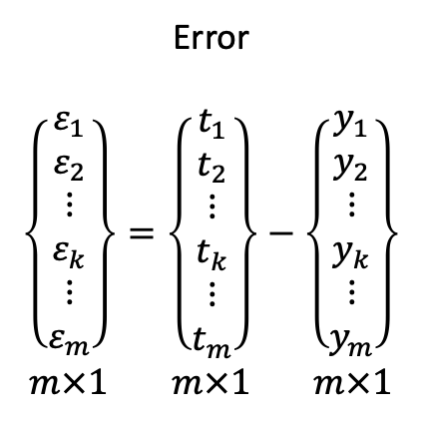
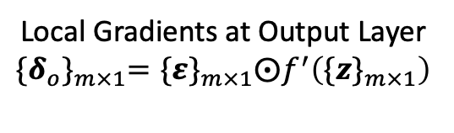

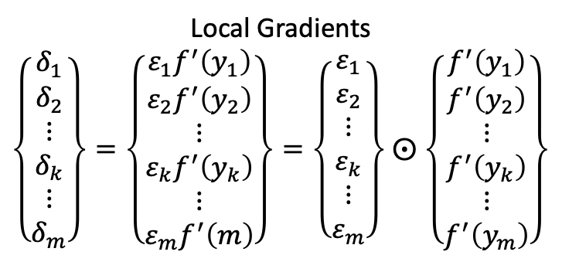
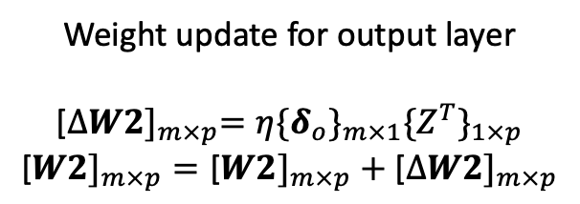
Backpropagation Step – Output Layer
Error
$$\left\{\begin{matrix}\begin{matrix}ε_{1} \\ ε_{2}\end{matrix} \\ \begin{matrix}⋮ \\ ε_{k}\end{matrix} \\ \begin{matrix}⋮ \\ ε_{m}\end{matrix}\end{matrix}\right\}=\left\{\begin{matrix}\begin{matrix}t_{1} \\ t_{2}\end{matrix} \\ \begin{matrix}⋮ \\ t_{k}\end{matrix} \\ \begin{matrix}⋮ \\ t_{m}\end{matrix}\end{matrix}\right\}−\left\{\begin{matrix}\begin{matrix}y_{1} \\ y_{2}\end{matrix} \\ \begin{matrix}⋮ \\ y_{k}\end{matrix} \\ \begin{matrix}⋮ \\ y_{m}\end{matrix}\end{matrix}\right\}$$
$$\begin{matrix}m×1 & m×1 & m×1\end{matrix}$$
1
$${w1}_{01}$$
1
$${w2}_{01}$$
Errors and Mean-Square Error
$${\{ε\}}_{m×1}={\{t\}}_{m×1}−{\{y\}}_{m×1}$$
$$⇒ MSE= \frac{1}{2}{\{ε^{T}\}}_{1×m}{\{ε\}}_{m×1}$$
$${w1}_{02}$$
$${w2}_{02}$$
X₁
$${w1}_{11}$$
Z₁
$${w2}_{11}$$
Y₁
$${w1}_{12}$$
$${w2}_{12}$$
X₂
Z₂
Y₂
$${w1}_{2p}$$
$${w2}_{2m}$$
Local Gradients
$\left\{\begin{matrix}\begin{matrix}δ_{1} \\ δ_{2}\end{matrix} \\ \begin{matrix}⋮ \\ δ_{k}\end{matrix} \\ \begin{matrix}⋮ \\ δ_{m}\end{matrix}\end{matrix}\right\}=\left\{\begin{matrix}\begin{matrix}ε_{1}f^{′}\left(y_{1}\right) \\ ε_{2}f^{′}\left(y_{2}\right)\end{matrix} \\ \begin{matrix}⋮ \\ ε_{k}f^{′}\left(y_{k}\right)\end{matrix} \\ \begin{matrix}⋮ \\ ε_{m}f^{′}\left(m\right)\end{matrix}\end{matrix}\right\}=\left\{\begin{matrix}\begin{matrix}ε_{1} \\ ε_{2}\end{matrix} \\ \begin{matrix}⋮ \\ ε_{k}\end{matrix} \\ \begin{matrix}⋮ \\ ε_{m}\end{matrix}\end{matrix}\right\}$ $⨀$ $\left\{\begin{matrix}\begin{matrix}f^{′}\left(y_{1}\right) \\ f^{′}\left(y_{2}\right)\end{matrix} \\ \begin{matrix}⋮ \\ f^{′}\left(y_{k}\right)\end{matrix} \\ \begin{matrix}⋮ \\ f^{′}\left(y_{m}\right)\end{matrix}\end{matrix}\right\}$
X_{i}
Z_{j}
Y_{k}
$${w1}_{ij}$$
$${w2}_{jk}$$
$${w1}_{ip}$$
$$w_{2jm}$$
X_{n}
Z_{p}
Y_{m}
$${w1}_{np}$$
$${w2}_{pm}$$
Weight update for output layer
$$\text{[}{∆W2]}_{m×p}=η{\{δ_{o}\}}_{m×1}{\{Z^{T}\}}_{1×p}$$
$$\text{[}{W2]}_{m×p}=\text{[}{W2]}_{m×p}+\text{[}{∆W2]}_{m×p}$$
Local Gradients at Output Layer
$${\{δ_{o}\}}_{m×1}={\{ε\}}_{m×1}⨀f^{′}\left({\{z\}}_{m×1}\right)$$
Weight changes are calculated
Actual weight update is done when we
complete the backpropagation of errors
Two-Layer Feedforward Neural Network

Slide 17
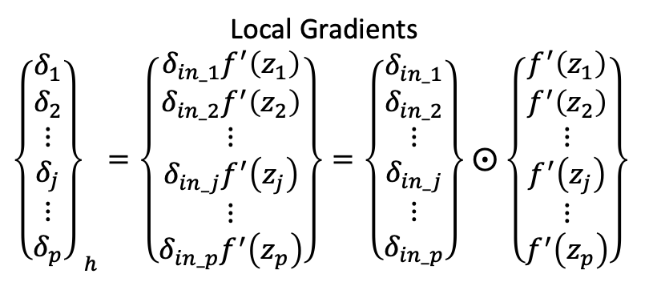
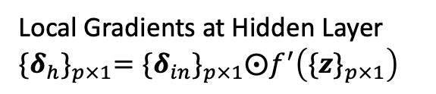

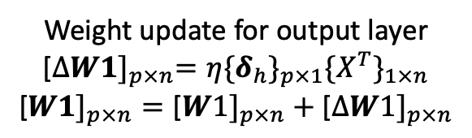
Backpropagation Step – Hidden Layer
Weighted sum of errors reaching the hidden units
1
$${w1}_{01}$$
1
$${w2}_{01}$$
$${\{δ_{in}\}}_{p×1}=\text{[}{{W2}^{T}]}_{p×m}{\{δ_{o}\}}_{m×1}$$
$${w1}_{02}$$
$${w2}_{02}$$
X₁
$${w1}_{11}$$
Z₁
$${w2}_{11}$$
Y₁
Local Gradients
${\left\{\begin{matrix}\begin{matrix}δ_{1} \\ δ_{2}\end{matrix} \\ \begin{matrix}⋮ \\ δ_{j}\end{matrix} \\ \begin{matrix}⋮ \\ δ_{p}\end{matrix}\end{matrix}\right\}}_{h}=\left\{\begin{matrix}\begin{matrix}δ_{in_1}f^{′}\left(z_{1}\right) \\ δ_{in_2}f^{′}\left(z_{2}\right)\end{matrix} \\ \begin{matrix}⋮ \\ δ_{in_j}f^{′}\left(z_{j}\right)\end{matrix} \\ \begin{matrix}⋮ \\ δ_{in_p}f^{′}\left(z_{p}\right)\end{matrix}\end{matrix}\right\}=\left\{\begin{matrix}\begin{matrix}δ_{in_1} \\ δ_{in_2}\end{matrix} \\ \begin{matrix}⋮ \\ δ_{in_j}\end{matrix} \\ \begin{matrix}⋮ \\ δ_{in_p}\end{matrix}\end{matrix}\right\}$ $⨀$ $\left\{\begin{matrix}\begin{matrix}f^{′}\left(z_{1}\right) \\ f^{′}\left(z_{2}\right)\end{matrix} \\ \begin{matrix}⋮ \\ f^{′}\left(z_{j}\right)\end{matrix} \\ \begin{matrix}⋮ \\ f^{′}\left(z_{p}\right)\end{matrix}\end{matrix}\right\}$
$${w1}_{12}$$
$${w2}_{12}$$
X₂
Z₂
Y₂
$${w1}_{2p}$$
$${w2}_{2m}$$
X_{i}
Z_{j}
Y_{k}
$${w1}_{ij}$$
$${w2}_{jk}$$
$${w1}_{ip}$$
$$w_{2jm}$$
Local Gradients at Hidden Layer
$${\{δ_{h}\}}_{p×1}={\{δ_{in}\}}_{p×1}⨀f^{′}\left({\{z\}}_{p×1}\right)$$
X_{n}
Z_{p}
Y_{m}
$${w1}_{np}$$
$${w2}_{pm}$$
Weight update for output layer
$$\text{[}{∆W1]}_{p×n}=η{\{δ_{h}\}}_{p×1}{\{X^{T}\}}_{1×n}$$
$$\text{[}{W1]}_{p×n}=\text{[}{W1]}_{p×n}+\text{[}{∆W1]}_{p×n}$$
Weight changes are calculated
Actual weight update is done when we complete
the backpropagation of errors
Two-Layer Feedforward Neural Network

Slide 18
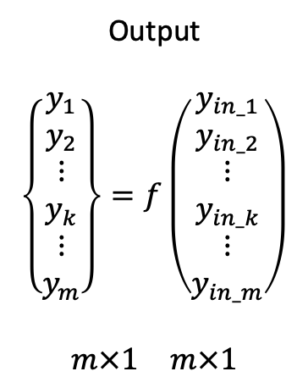

Output
$$\left\{\begin{matrix}\begin{matrix}y_{in_1} \\ y_{in_2}\end{matrix} \\ \begin{matrix}⋮ \\ y_{in_k}\end{matrix} \\ \begin{matrix}⋮ \\ y_{in_m}\end{matrix}\end{matrix}\right\}=$$
$$m×1$$
Weight Matrix – Output Layer
$$\left[\begin{matrix}\begin{matrix}\begin{matrix}\begin{matrix}{w2}_{11} \\ {w2}_{12}\end{matrix} \\ \begin{matrix}⋮ \\ {w2}_{1k}\end{matrix} \\ \begin{matrix}⋮ \\ {w2}_{1p}\end{matrix}\end{matrix} & \begin{matrix}\begin{matrix}{w2}_{21} \\ {w2}_{22}\end{matrix} \\ \begin{matrix}⋮ \\ {w2}_{2k}\end{matrix} \\ \begin{matrix}⋮ \\ {w2}_{2p}\end{matrix}\end{matrix}\end{matrix} & \begin{matrix}\begin{matrix}\begin{matrix}⋯ \\ ⋯\end{matrix} \\ \begin{matrix}⋮ \\ ⋯\end{matrix} \\ \begin{matrix}⋮ \\ ⋯\end{matrix}\end{matrix} & \begin{matrix}\begin{matrix}{w2}_{j1} \\ {w2}_{j2}\end{matrix} \\ \begin{matrix}⋮ \\ {w2}_{ik}\end{matrix} \\ \begin{matrix}⋮ \\ {w2}_{jp}\end{matrix}\end{matrix}\end{matrix} & \begin{matrix}\begin{matrix}\begin{matrix}⋯ \\ ⋯\end{matrix} \\ \begin{matrix}⋮ \\ ⋯\end{matrix} \\ \begin{matrix}⋮ \\ ⋯\end{matrix}\end{matrix} & \begin{matrix}\begin{matrix}{w2}_{p1} \\ {w2}_{p2}\end{matrix} \\ \begin{matrix}⋮ \\ {w2}_{pk}\end{matrix} \\ \begin{matrix}⋮ \\ {w2}_{pm}\end{matrix}\end{matrix}\end{matrix}\end{matrix}\right]$$
$$m×p$$
Hidden
$$\left\{\begin{matrix}\begin{matrix}z_{1} \\ z_{2}\end{matrix} \\ \begin{matrix}⋮ \\ z_{i}\end{matrix} \\ \begin{matrix}⋮ \\ z_{p}\end{matrix}\end{matrix}\right\}$$
$$p×1$$
Bias
$$+\left\{\begin{matrix}\begin{matrix}{w2}_{01} \\ {w2}_{02}\end{matrix} \\ \begin{matrix}⋮ \\ {w2}_{0k}\end{matrix} \\ \begin{matrix}⋮ \\ {w2}_{0m}\end{matrix}\end{matrix}\right\}$$
$$m×1$$
Backpropagation Step
Errors and Mean-Square Error
$${\{ε\}}_{m×1}=\left[{\{t\}}_{m×1}−{\{Y\}}_{m×1}\right]$$
$$⇒ MSE= \frac{1}{2}{\{ε^{T}\}}_{1×m}{\{ε\}}_{m×1}$$
1
$${w1}_{01}$$
1
$${w2}_{01}$$
$${w1}_{02}$$
$${w2}_{02}$$
X₁
$${w1}_{11}$$
Z₁
$${w2}_{11}$$
Y₁
$${w1}_{12}$$
$${w2}_{12}$$
Output
$$\left\{\begin{matrix}\begin{matrix}y_{1} \\ y_{2}\end{matrix} \\ \begin{matrix}⋮ \\ y_{k}\end{matrix} \\ \begin{matrix}⋮ \\ y_{m}\end{matrix}\end{matrix}\right\}=f\left(\begin{matrix}\begin{matrix}y_{in_1} \\ y_{in_2}\end{matrix} \\ \begin{matrix}⋮ \\ y_{in_k}\end{matrix} \\ \begin{matrix}⋮ \\ y_{in_m}\end{matrix}\end{matrix}\right)$$
$$\begin{matrix}m×1 & m×1\end{matrix}$$
Output
$$\left\{\begin{matrix}\begin{matrix}y_{1} \\ y_{2}\end{matrix} \\ \begin{matrix}⋮ \\ y_{k}\end{matrix} \\ \begin{matrix}⋮ \\ y_{m}\end{matrix}\end{matrix}\right\}$$
$$m×1$$
X₂
Z₂
Y₂
$${w1}_{2p}$$
$${w2}_{2m}$$
X_{i}
Z_{j}
Y_{k}
$${w1}_{ij}$$
$${w2}_{jk}$$
$${w1}_{ip}$$
$$w_{2jm}$$
X_{n}
Z_{p}
Y_{m}
$${w1}_{np}$$
$${w2}_{pm}$$
Two-Layer Feedforward Neural Network

Slide 19



















Standard Backpropagation with Two-Layer Feedforward Neural Network
1
1
[${B1]}_{N_{h}×1}$
Hidden
Layer
[${B2]}_{N_{o}×1}$
Output
Layer
Input
Layer
[${W1]}_{N_{h}×N_{i}}$
[${W2]}_{N_{o}×N_{h}}$
$${\{X\}}_{N_{i}×1}$$
$${\{A1\}}_{N_{h}×1}=f\left({Z1}_{N_{h}×1}\right)$$
$${\{A2\}}_{N_{o}×1}=f\left({Z2}_{N_{o}×1}\right)$$
Initialization
Input to the hidden units = weighted sum of inputs
Input to the output units = weighted sum of inputs
Feedforward
(signals)
$${\{Z1\}}_{N_{h}×1}={\{B1\}}_{N_{h}×1}\text{+ }\text{[}{W1]}_{N_{h}×N_{i}}{\{X\}}_{N_{i}×1}$$
$${\{Z2\}}_{N_{o}×1}={\{B2\}}_{N_{o}×1}\text{+}\text{[}{W2]}_{N_{o}×N_{h}}{\{A1\}}_{N_{h}×1}$$
Output of the hidden units
Output of the output layer units
$${\{A1\}}_{N_{h}×1}=f\left({\{Z1\}}_{N_{h}×1}\right)$$
$${\{Y\}}_{N_{o}×1}={\{A2\}}_{N_{o}×1}=f\left({\{Z2\}}_{N_{o}×1}\right)$$
Mean Squared
Error
$${\{ε\}}_{N_{o}×1}=\left[{\{t\}}_{N_{o}×1}−{\{Y\}}_{N_{o}×1}\right] ⇒ MSE= \frac{1}{2}{\{ε^{T}\}}_{1×N_{o}}{\{ε\}}_{N_{o}×1}$$
Backpropagation
(errors)
Weighted sum of errors reaching the hidden units
Local gradient at the output layer
$${\{δ_{in}\}}_{N_{h}×1}=\text{[}{{W2}^{T}]}_{N_{h}×N_{o}}{\{δ_{o}\}}_{N_{o}×1}$$
$${\{δ_{o}\}}_{N_{o}×1}={\{ε\}}_{N_{o}×1}⨀f^{′}\left({\{Z2\}}_{N_{o}×1}\right)$$
Local gradient at the hidden layer
Weight change
$${\{δ_{h}\}}_{N_{h}×1}={\{δ_{in}\}}_{N_{h}×1}⨀f^{′}\left({\{Z1\}}_{N_{h}×1}\right)$$
$$\text{[}{∆W2]}_{N_{o}×N_{h}}=η{\{δ_{o}\}}_{N_{o}×1}{\{{A1}^{T}\}}_{1×N_{h}}$$
Weight change
$$\text{[}{∆W1]}_{N_{h}×N_{i}}=η{\{δ_{h}\}}_{N_{h}×1}{\{X^{T}\}}_{1×N_{i}}$$
Weight Update
$$\text{[}{W1]}_{N_{h}×N_{i}}=\text{[}{W1]}_{N_{h}×N_{i}}+\text{[}{∆W1]}_{N_{h}×N_{i}}$$
$$\text{[}{W2]}_{N_{o}×N_{h}}=\text{[}{W2]}_{N_{o}×N_{h}}+\text{[}{∆W2]}_{N_{o}×N_{h}}$$
MSE Check
After an Epoch

Slide 20
Quick Recap
Deep Learning Feedforward Neural Network

Slide 21












Standard Backpropagation - Feedforward Neural Network – Many Layers!
$${\left[W\right]}_{N_{h1}×{(N}_{i}+1)}^{(1)}=\left[\begin{matrix}{\left[W\right]}_{N_{h1}×N_{i}}^{(1)} & {\left\{B\right\}}_{N_{h1}×1}^{(1)}\end{matrix}\right]$$
$${\left[W\right]}_{N_{h2}×{(N}_{h1}+1)}^{(2)}=\left[\begin{matrix}{\left[W\right]}_{N_{h2}×N_{h1}}^{(2)} & {\left\{B\right\}}_{N_{h2}×1}^{(2)}\end{matrix}\right]$$
$${\left[W\right]}_{N_{hL}×{(N}_{h(L−1)}+1)}^{(L)}=\left[\begin{matrix}{\left[W\right]}_{N_{hL}×N_{h(L−1)}}^{(L)} & {\left\{B\right\}}_{N_{hL}×1}^{(L)}\end{matrix}\right]$$
$${\left[W\right]}_{N_{o}×{(N}_{hL}+1)}^{(L+1)}=\left[\begin{matrix}{\left[W\right]}_{o×N_{hL}}^{(L+1)} & {\left\{B\right\}}_{N_{0}×1}^{(L+1)}\end{matrix}\right]$$
Input
Layer
Hidden
Layer
1
Hidden
Layer
2
Hidden
Layer
L
Output
Layer
$${\left[W\right]}_{N_{h1}×{(N}_{i}+1)}^{(1)}$$
$${\left[W\right]}_{N_{h2}×{(N}_{h1}+1)}^{(2)}$$
$${\left[W\right]}_{N_{hL}×{(N}_{h(L−1)}+1)}^{(L)}$$
$${\left[W\right]}_{N_{o}×{(N}_{hL}+1)}^{(L+1)}$$
$${\{X\}}_{N_{i}×1}$$
$${\left\{A\right\}}_{N_{h1}×1}^{(1)}=f\left({\left[W\right]}_{N_{h1}×{(N}_{i}+1)}^{(1)}{\{X\}}_{{(N}_{i}+1)×1}\right)$$
$${\left\{A\right\}}_{N_{hL}×1}^{(L)}=f\left({\left[W\right]}_{N_{hL}×{(N}_{h(L−1)}+1)}^{(L)}{\left\{A\right\}}_{{(N}_{h(L−1)}+1)×1}^{(L)}\right)$$
$${\left\{A\right\}}_{N_{h2}×1}^{(2)}=f\left({\left[W\right]}_{N_{h2}×{(N}_{h1}+1)}^{(2)}{\left\{A\right\}}_{{(N}_{h1}+1)×1}^{(1)}\right)$$
$${\left\{A\right\}}_{N_{o}×1}^{(L+1)}=f\left({\left[W\right]}_{N_{o}×{(N}_{L}+1)}^{(L+1)}{\left\{A\right\}}_{{(N}_{L}+1)×1}^{(L)}\right)$$

Slide 22
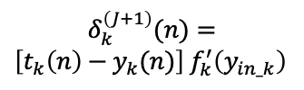
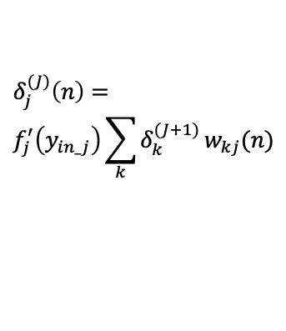



Quick Recap
Deep Learning Feedforward Neural Network
$$δ_{1}^{(J+1)}\left(n\right)$$
$$δ_{2}^{(J+1)}\left(n\right)$$
$$δ_{k}^{\left(J+1\right)}(n)=$$
$\left[t_{k}\left(n\right)−y_{k}(n)\right]$ $f_{k}^{′}\left(y_{in_k}\right)$
$$δ_{j}^{(J)}\left(n\right)=$$
$$f_{j}^{′}\left(y_{in_j}\right)\sum_{k}{δ_{k}^{(J+1)}}w_{kj}(n)$$
$$δ_{m}^{(J+1)}\left(n\right)$$

Slide 23
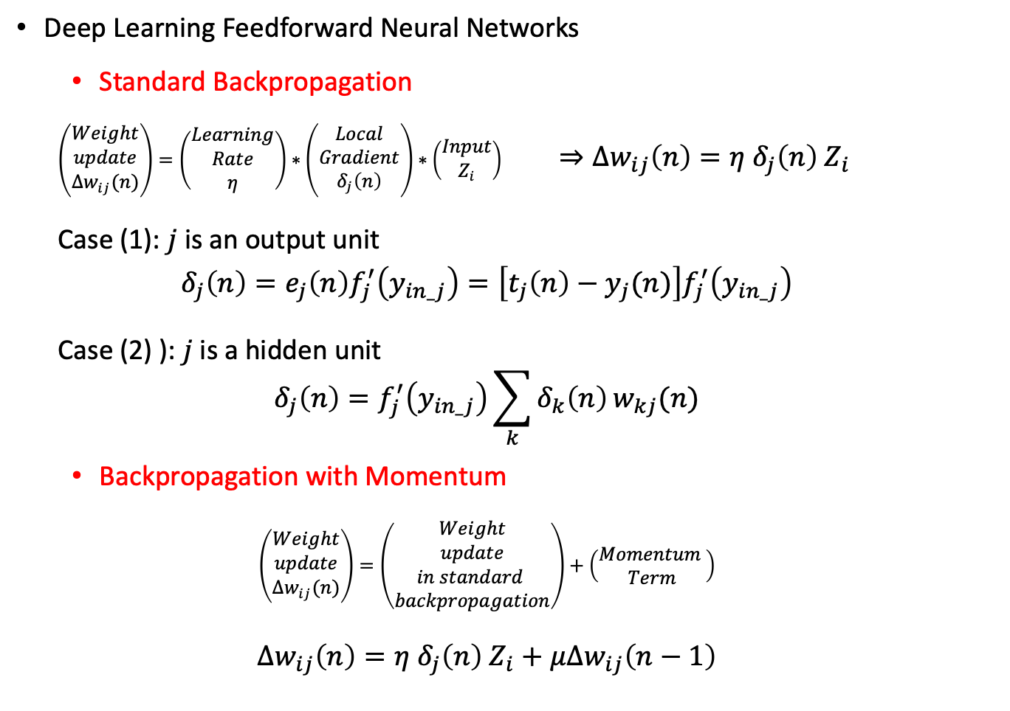
Quick Recap
Deep Learning Feedforward Neural Networks
Standard Backpropagation
$\left(\begin{aligned}Weight \\ update \\ ∆w_{ij}(n)\end{aligned}\right)=\left(\begin{aligned}Learning \\ Rate \\ η\end{aligned}\right)∗\left(\begin{aligned}Local \\ Gradient \\ δ_{j}\left(n\right)\end{aligned}\right)∗\left(\begin{aligned}Input \\ Z_{i}\end{aligned}\right)$ $⇒∆w_{ij}\left(n\right)=η δ_{j}\left(n\right) Z_{i}$
Case (1): $j$ is an output unit
$$δ_{j}\left(n\right)=e_{j}\left(n\right)f_{j}^{′}\left(y_{in_j}\right)=\left[t_{j}\left(n\right)−y_{j}(n)\right]f_{j}^{′}\left(y_{in_j}\right)$$
Case (2) ): $j$ is a hidden unit
$$δ_{j}\left(n\right)=f_{j}^{′}\left(y_{in_j}\right)\sum_{k}{δ_{k}\left(n\right)}w_{kj}(n)$$
Backpropagation with Momentum
$$\left(\begin{aligned}Weight \\ update \\ ∆w_{ij}(n)\end{aligned}\right)=\left(\begin{aligned}Weight \\ update \\ in standard \\ backpropagation\end{aligned}\right)+\left(\begin{aligned}Momentum \\ Term\end{aligned}\right)$$
$$∆w_{ij}\left(n\right)=η δ_{j}\left(n\right) Z_{i}+μ∆w_{ij}\left(n−1\right)$$

Slide 24
Questions …
Number of neurons in input and output layer? (Problem specific)
How many hidden layers?
How many units in each hidden layer?
What should be the initial parameters of the net ?
weights, bias,
learning rate,
activation functions
Pattern-by-pattern weight update or Batch weight updates?

Slide 25
DL and ML - Python Libraries
Numpy
Matplotlib
Tensorflow
Pytorch
Keras
Pandas
Scikit-learn
Scipy
Theano
Seaborn
Bokeh
Poltly
PyBrain
… over 30000 library packages
Os
Datetime
Cvs
Json
Openpyxl
Scapy
Beautiful soup
Pipenv
Pillow – open cv

